Slide 1
01
Executive Summary and
Business Use Case

Slide 2
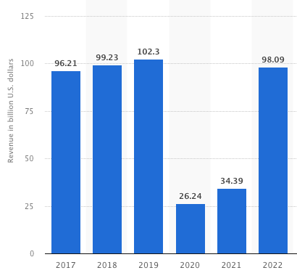
Executive Summary
The hospitality industry encountered significant challenges during the COVID-19 pandemic due to restricted governance and health conditions¹. Furthermore, the current client demand for flexibility in cancellation has resulted in a decline in occupancy rates.
To address this, an effective strategy is to accurately predict cancellation rates.
In order to enhance prediction accuracy, we adopted a mixed methods approach, utilizing customer behavior, public data, and governmental data to identify trends related to cancellations, weather, and economic conditions. Aims to optimize hotel resource allocation and maximize revenue.
Revenue of the hotel market in Europe¹
(in billion U.S. dollars)
Notes:
[1] Revenue of the hotel market in Europe from 2017 to 2022, with a forecast until 2027(in billion U.S. dollars), Statista Mobility Market Insights
https://www.statista.com/forecasts/1388860/hotel-revenue-europe

Slide 3
Research Objective
Investigate the impact of internal (consumer attributes) and external factors on cancellation rates
Utilize data analytics and modeling to predictive dynamically cancellation rates
Provide data driven insights and mitigate the effects on cancellation rates
Identify significant feature
Optimize marketing strategies and operation efficiency
Maximize the overbook rate while maintaining customer satisfaction

Slide 4






Data Planning
Data Preparation & Processing
Data Warehouse
Data Analytics & Visualization
Data Collection

Slide 5
02
ETL
Data Extract

Slide 6

Data Profile
Data Definition | Data Source | Data Size | Rows/Column
Resort hotel booking | ScienceDirect website Extracted from hotels’ Property Management System (PMS) SQL databases | 8.1 MB | (40060, 31)
City hotel booking | ScienceDirect website Extracted from hotels’ Property Management System (PMS) SQL databases | 16 MB | (79330, 31)
Economic indicator data | IMF Website | 12 KB | (27, 8)
Weather data | Visual Crossing website | 49 KB | (823, 8)
Number of tourists | Instituto Nacional de Estadística | 12 KB | (1, 31)
Notes:
Website Link
Resort Hotel: https://doi.org/10.1016/j.dib.2018.11.126
City Hotel: https://doi.org/10.1016/j.dib.2018.11.126
Economic Data: https://data.imf.org/regular.aspx?key=61545849
Weather Data: https://www.visualcrossing.com/
Holiday Data: https://www.timeanddate.com/holidays/portugal/2015
Number of tourists by country of residence: https://www.ine.es/jaxiT3/Datos.htm?t=10822#!tabs-table
Guests and overnight stays by country of residence: https://www.ine.es/jaxiT3/Datos.htm?t=10822#!tabs-tabla

Slide 7
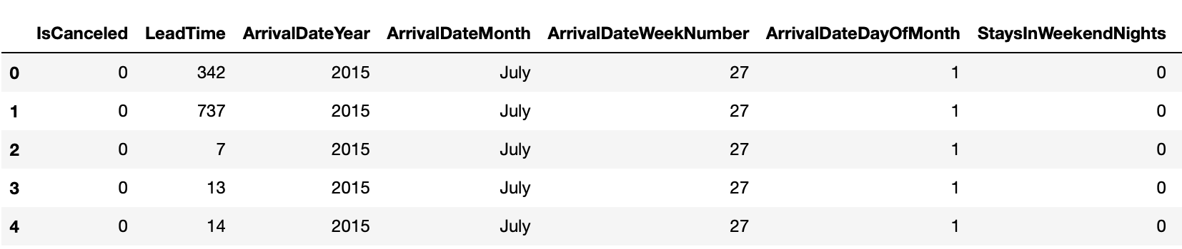
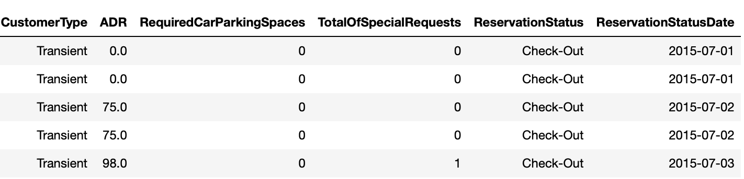
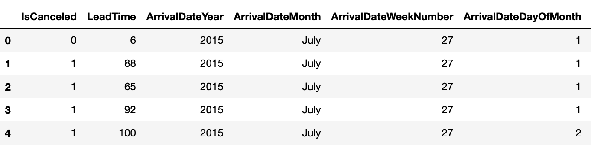
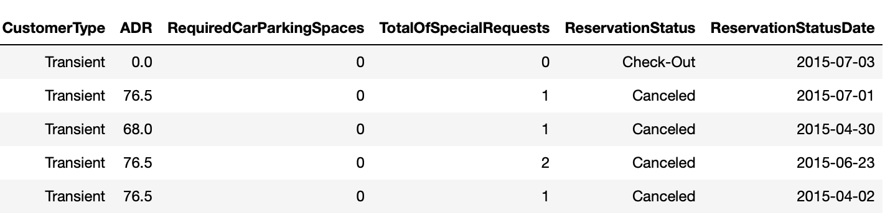
Data Profile – Hotel Data
Goal: To optimize cancellation rate predictions and provide tailored recommendations for hotels in Europe
Characteristics:
1. Transactions in Resort and City Hotel in Lisbon with arrival date between July 1, 2015, and August 31, 2017
2. Includes booking status (i.e. ReservationStatus), payment information (i.e. DepositType), guest profile (i.e. Adults, Children), bookings detail (i.e. ArrivalDateMonth, ReservationStatusDate), types of room reserved and assigned to the guests (i.e. ReservedRoomType, AssignedRoomType), etc.
Resort Hotel Data
…
…
…
…
…
…
City Hotel Data
…
…
…
…
…
…

Slide 8
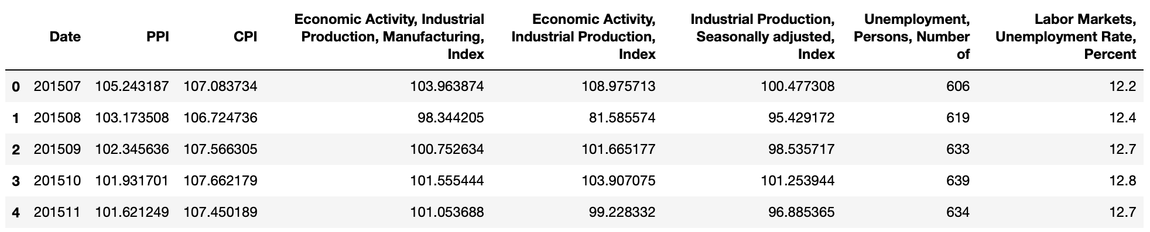
Data Profile – Economic Data
Goal: To optimize cancellation rate predictions by identifying factors related to hotel guests' financial status, such as unemployment rate and Price Index
Characteristics:
1. Economic data for the Lisbon region between July 2015 and August 2017
2. Includes Consumer Price Index, Production Index, and unemployment rate indicators presented in monthly average values

Slide 9
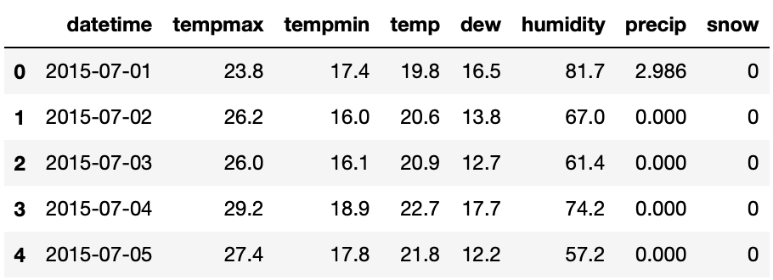
Data Profile – Weather Data
Goal: To assess the influence of weather conditions on guests' travel plans and explore any potential correlation with booking cancellations
Characteristics:
1. Average weather condition in Lisbon region between July 1, 2015, and September 30, 2017
2. Includes temperature-related information, humidity values, precipitation, and snow presented as daily averages

Slide 10
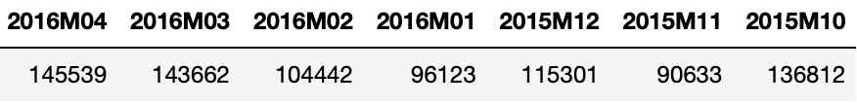
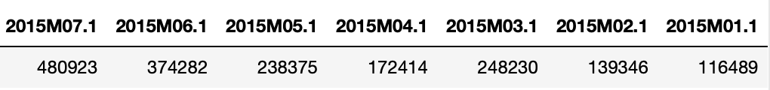
Data Profile – Tourist Data
Goal: To study monthly travel popularity fluctuations in Lisbon and understand its correlation with our hotel booking data
Characteristics: ‘Number of Tourists Data’ includes the monthly number of tourist travelling across Portugal border between Jul 2015 and Dec 2017
Guests of Overnight Stays Data
Number of Tourists Data

Slide 11

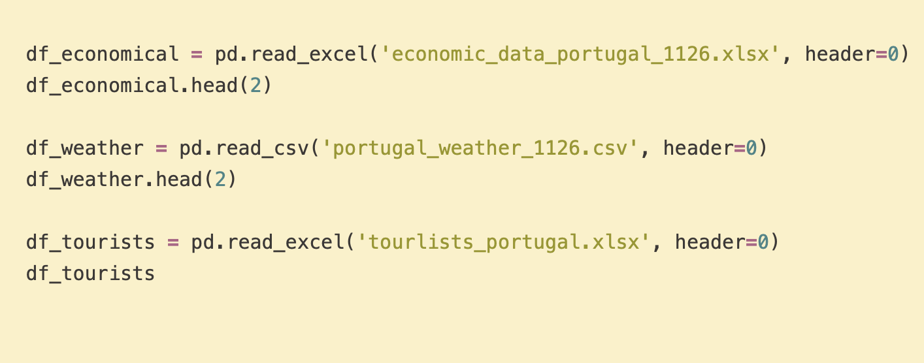
Data Profile
Main dataset:
Import the dataset into Jupyter Notebook using Pandas
Explore the DataFrame to understand the data
Get ready for data transformation
Resort & City Hotel Booking
- reservation status, guest, payment, arrival date, etc
Supporting dataset:
Economic Indicator
- CPI, PPI, unemployment rate, etc
Weather Data
- temperature, humidity, snow, etc
Tourism Data
- Tourist(total & stay overnight) number per month

Slide 12
05
EDA and Visualization

Slide 13
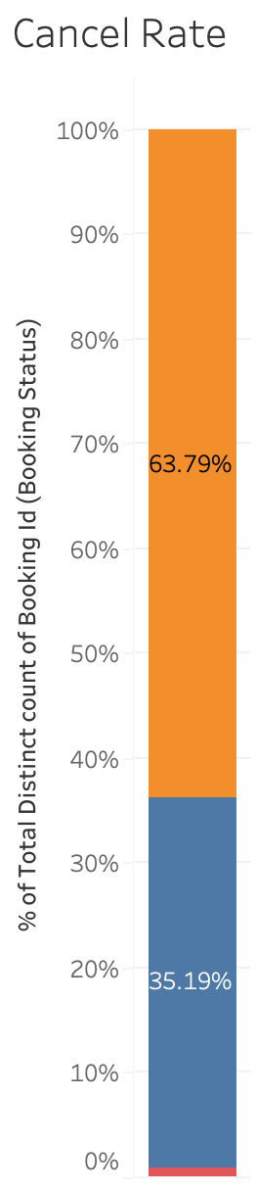
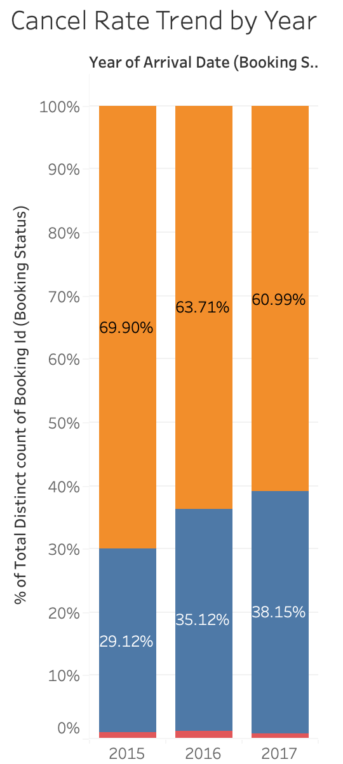
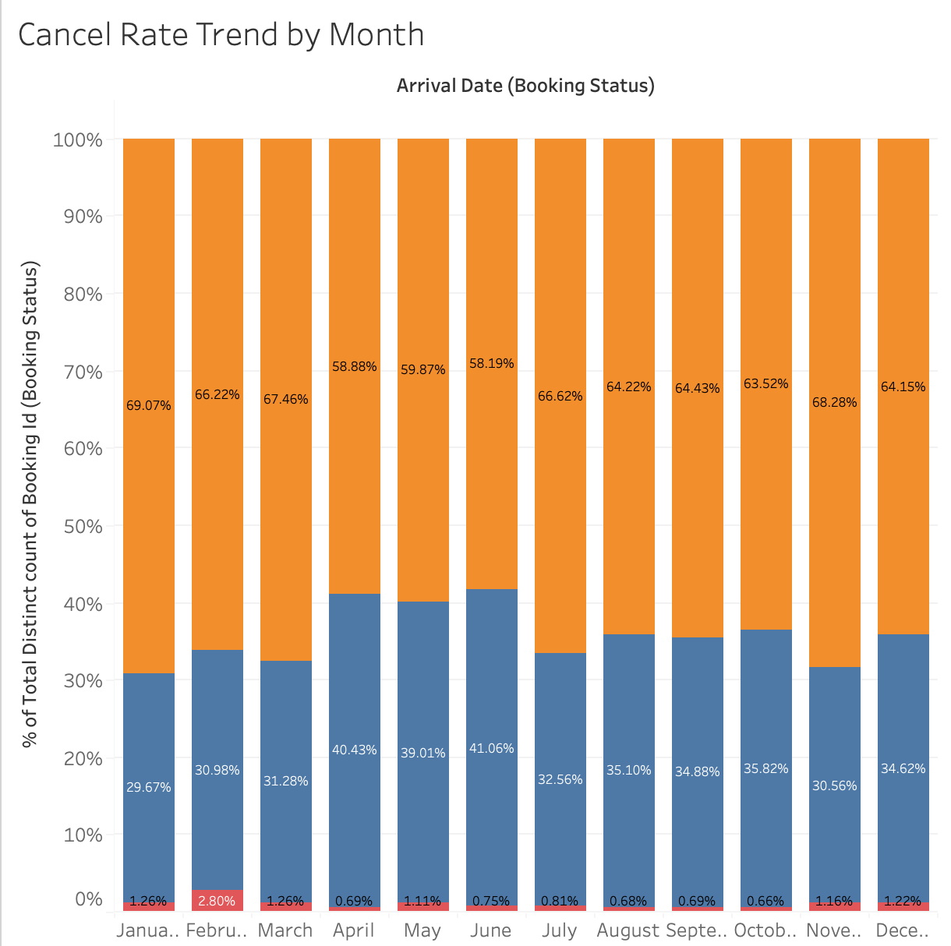
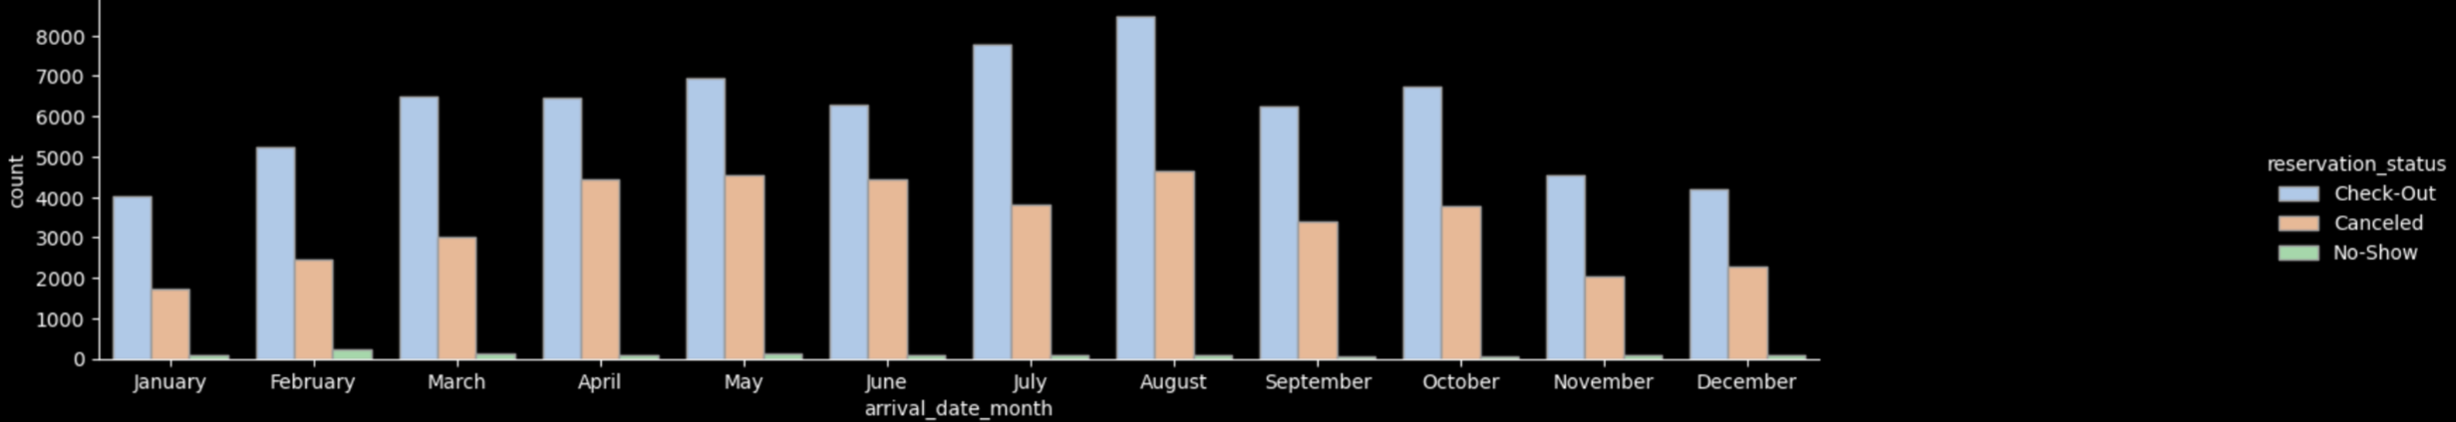
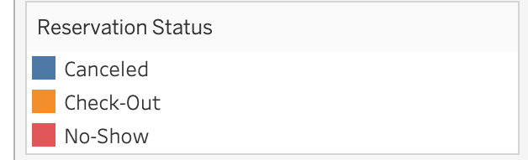
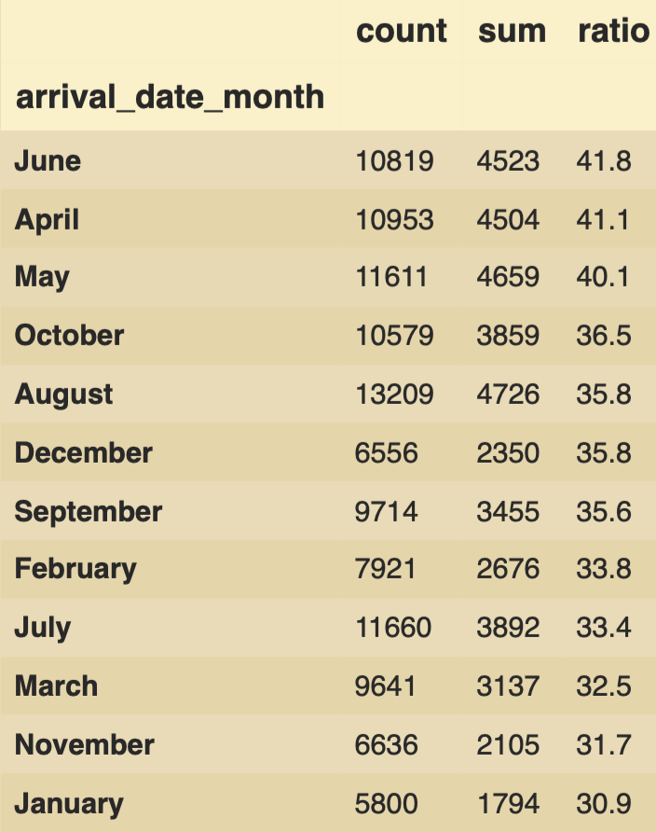
Cancellation Trend
The average cancellation rate is 35.19%.
There is a growing trend of cancellation rates, increasing from 29% in 2015 to 38% in 2017.
There is seasonal fluctuation, with a higher cancellation rate from April to June; The seasonal fluctuation remained consistent across the years.
Emphasize we analyze cancellation rate (our focus), and its's blue

Slide 14
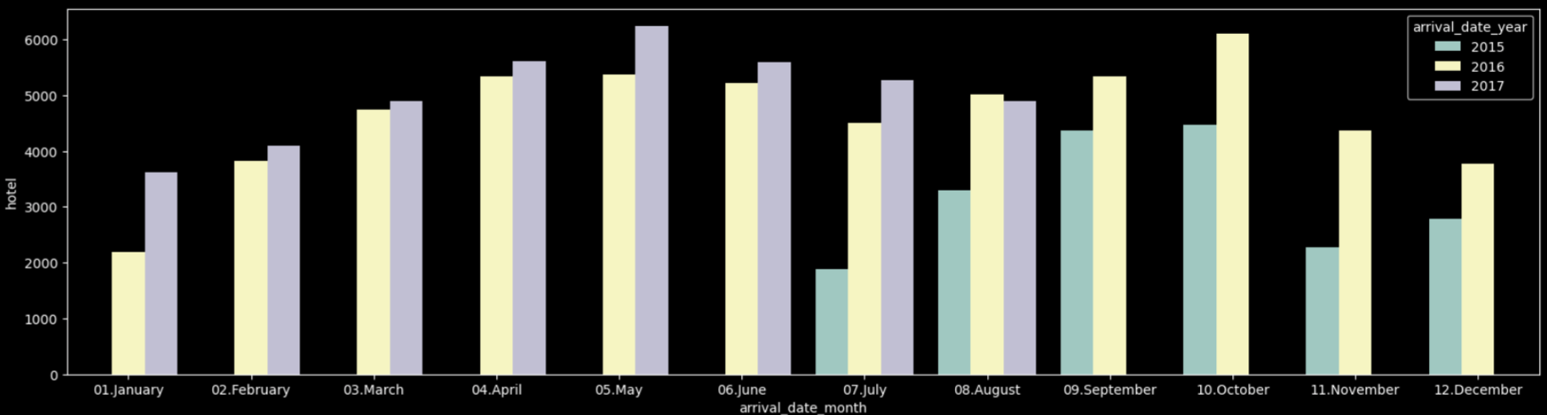
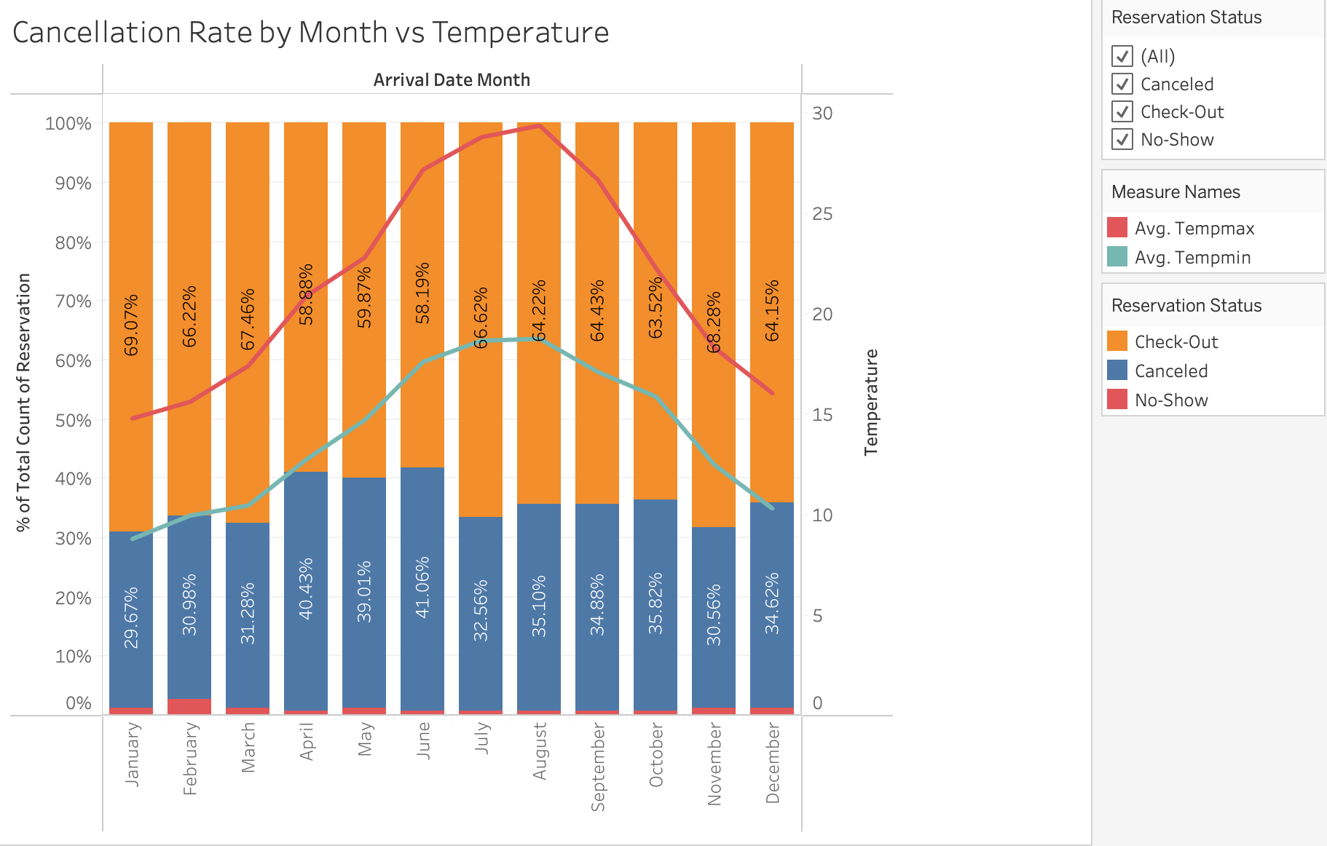
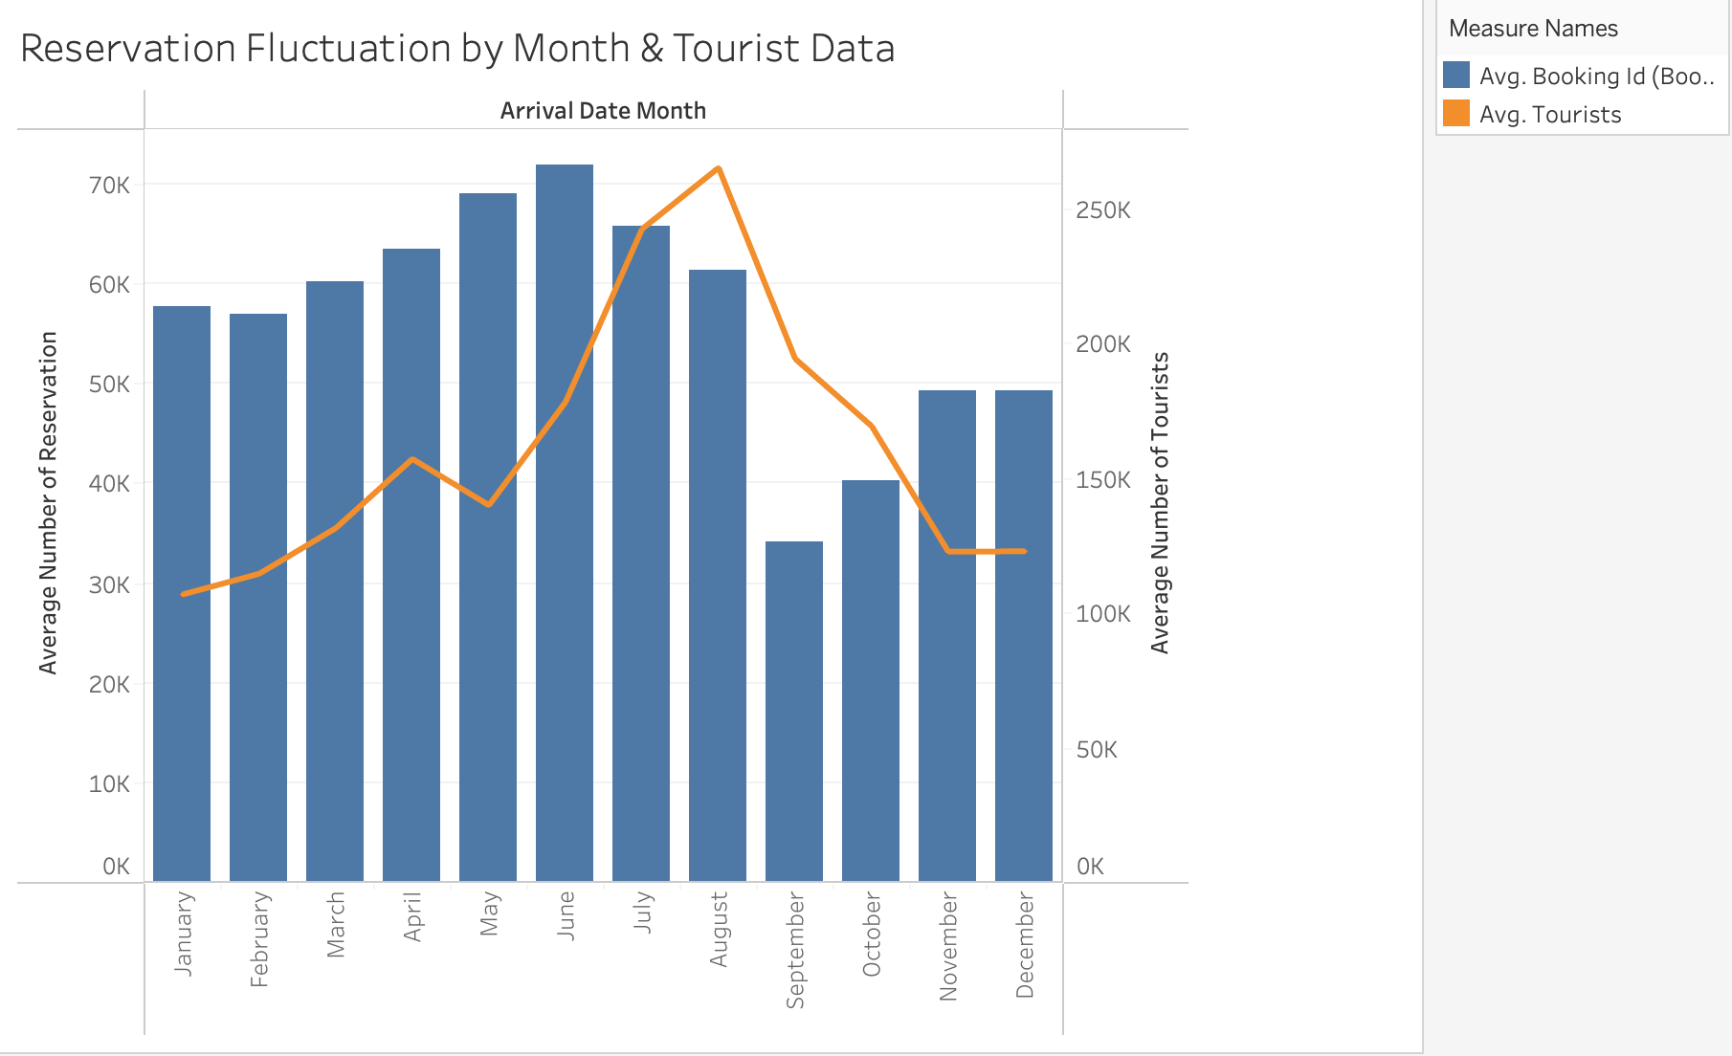
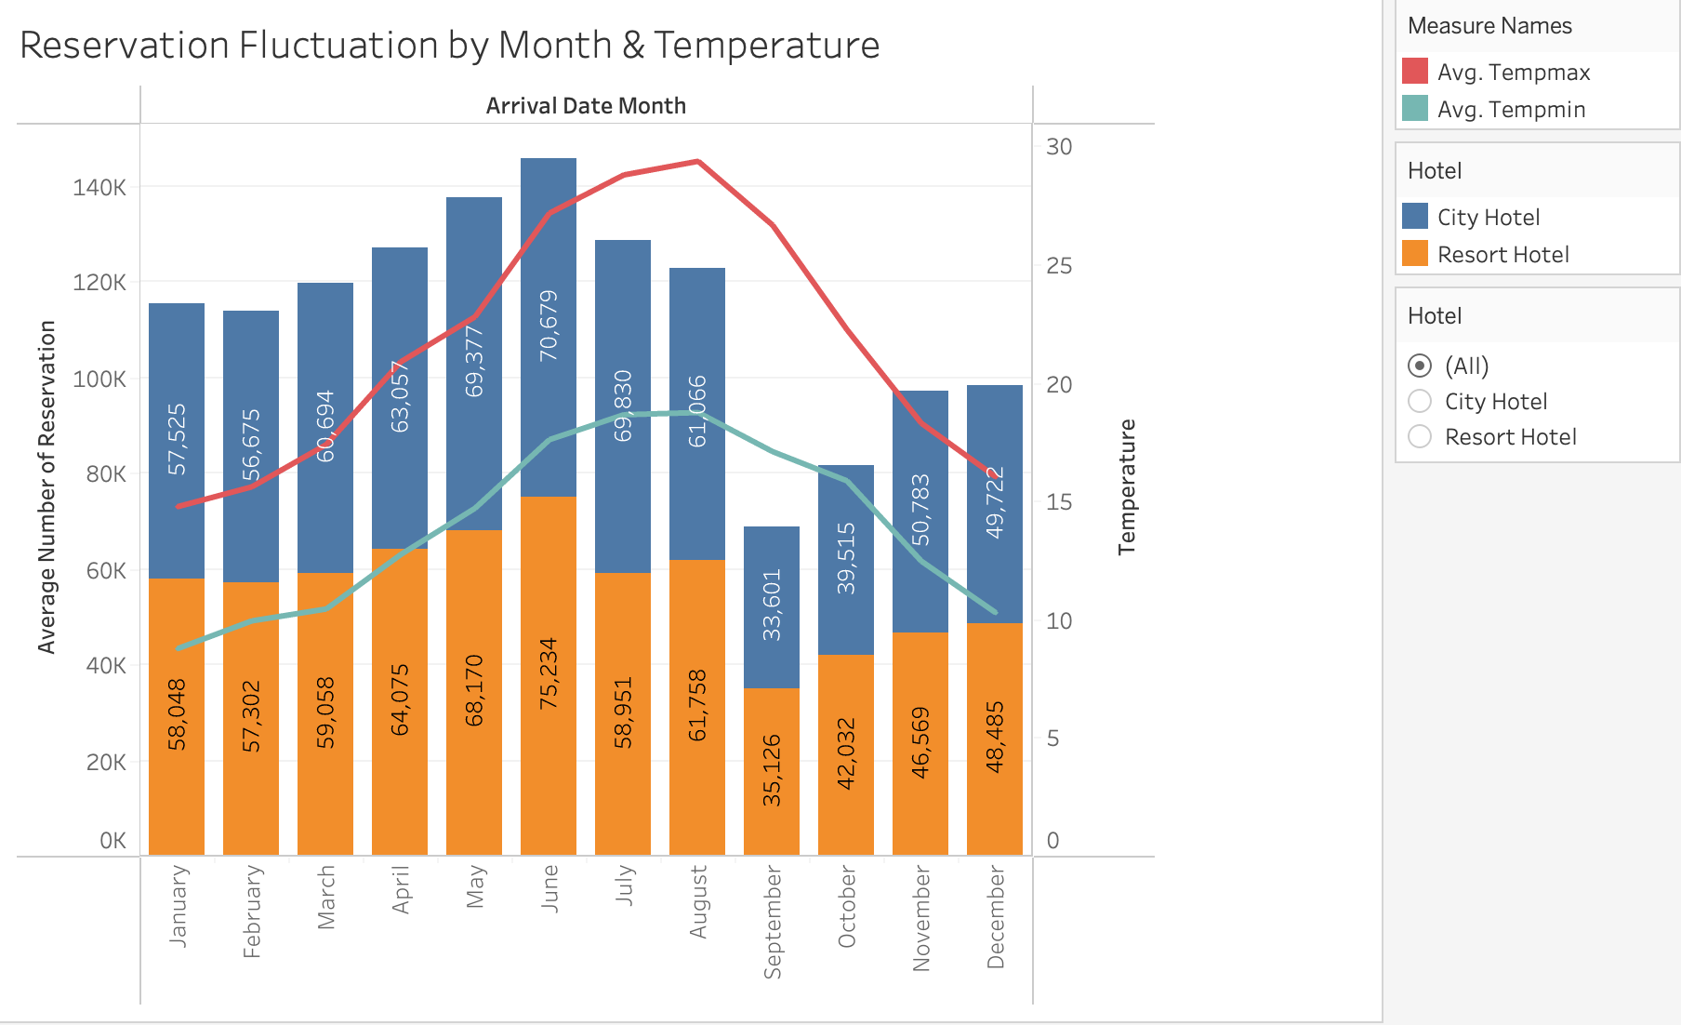
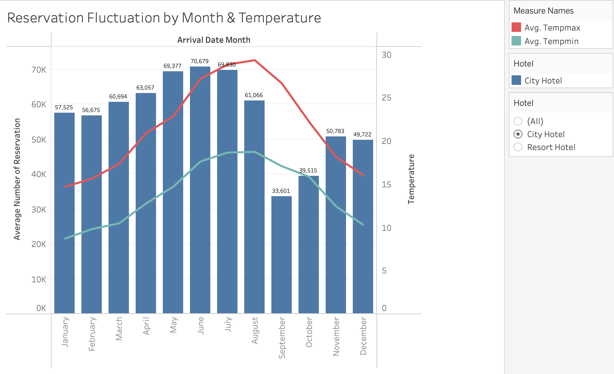
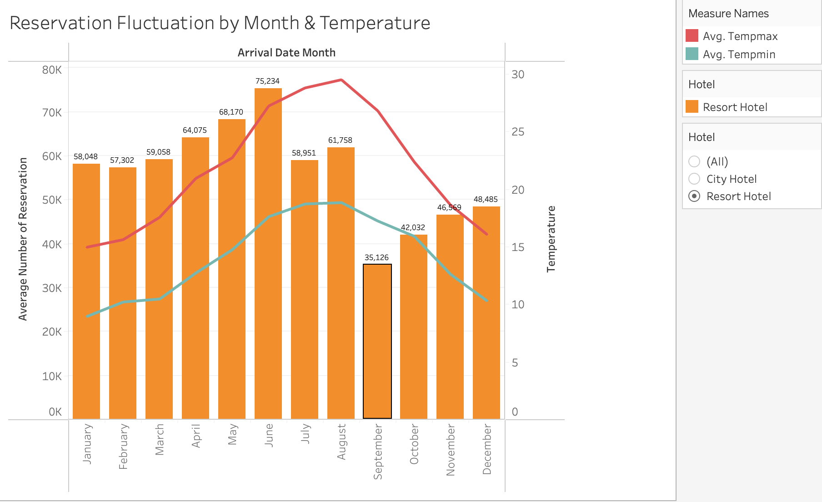
Cancellation Fluctuation by Temperature
Temperature does not have a significant relationship with the cancellation rate.
Hard to predict the weather on arrival date – easy to understand why there's not significant relationship

Slide 15
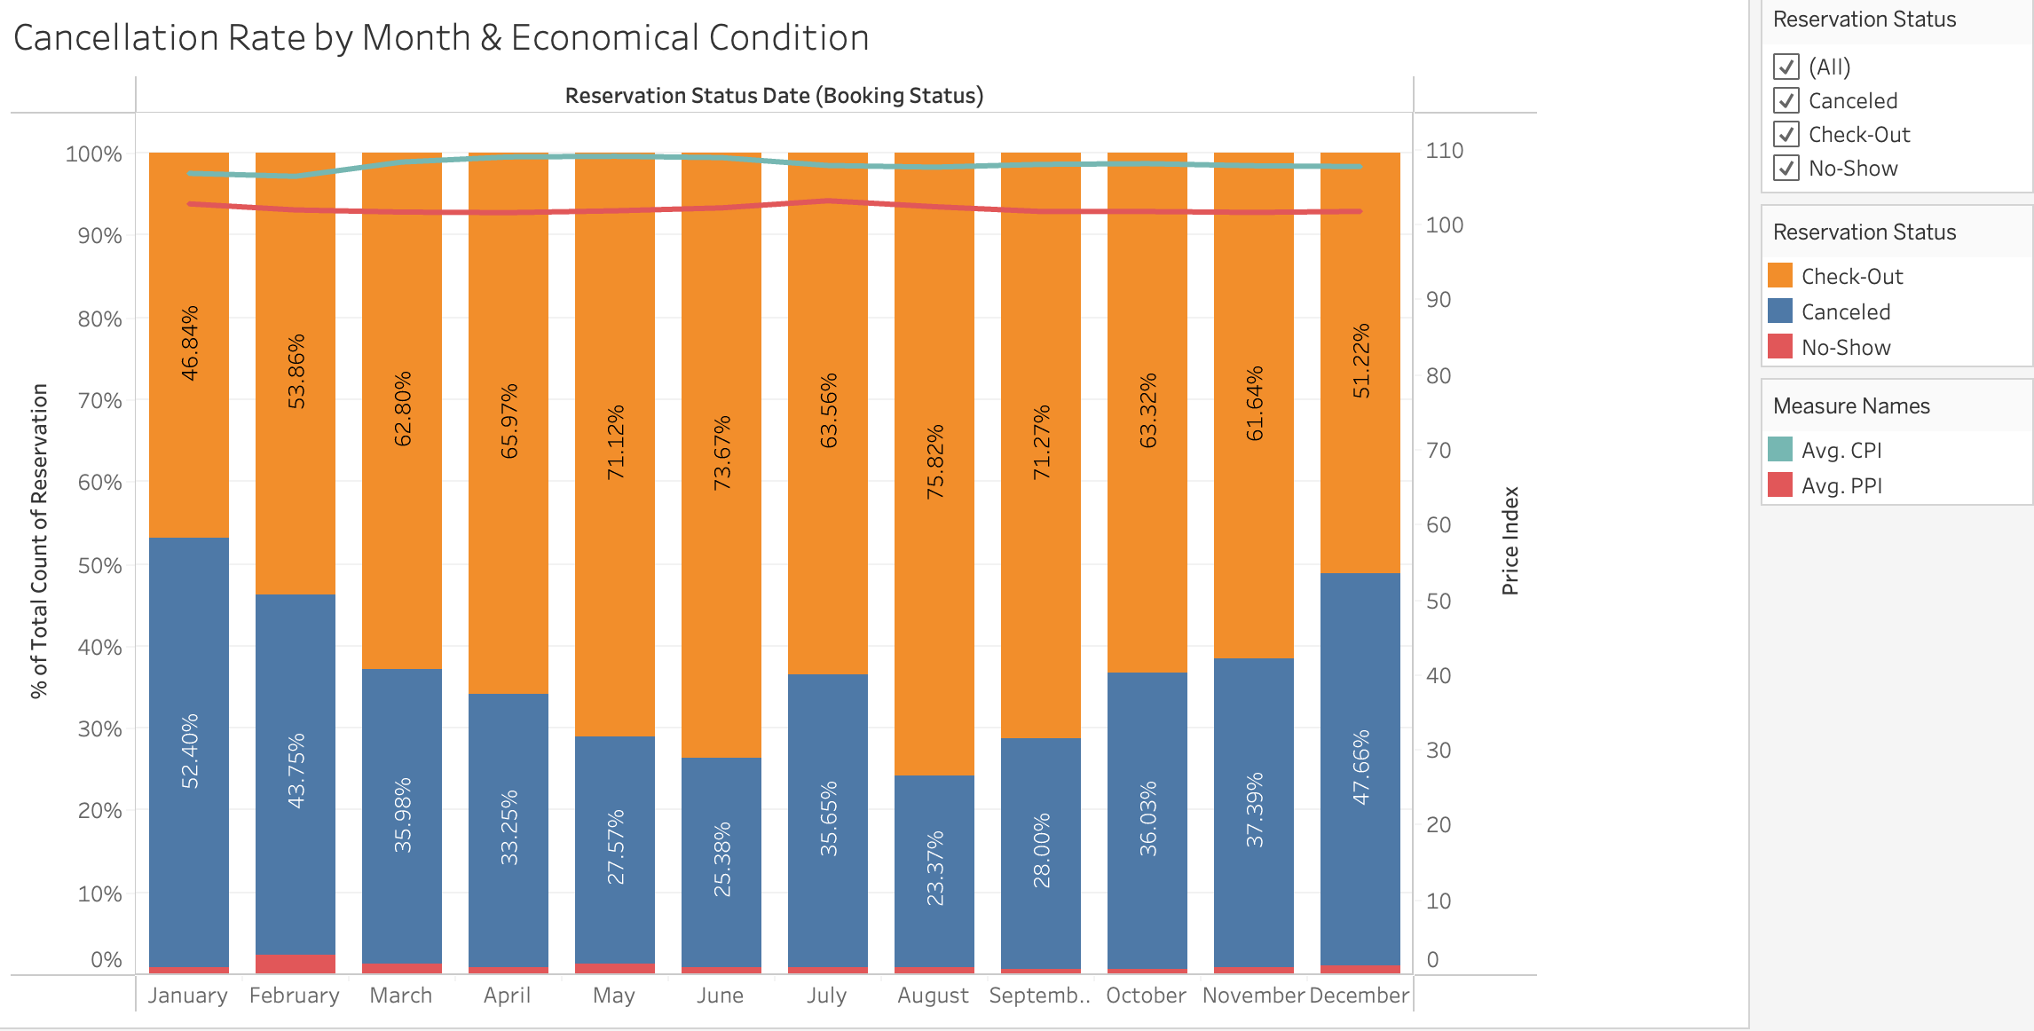
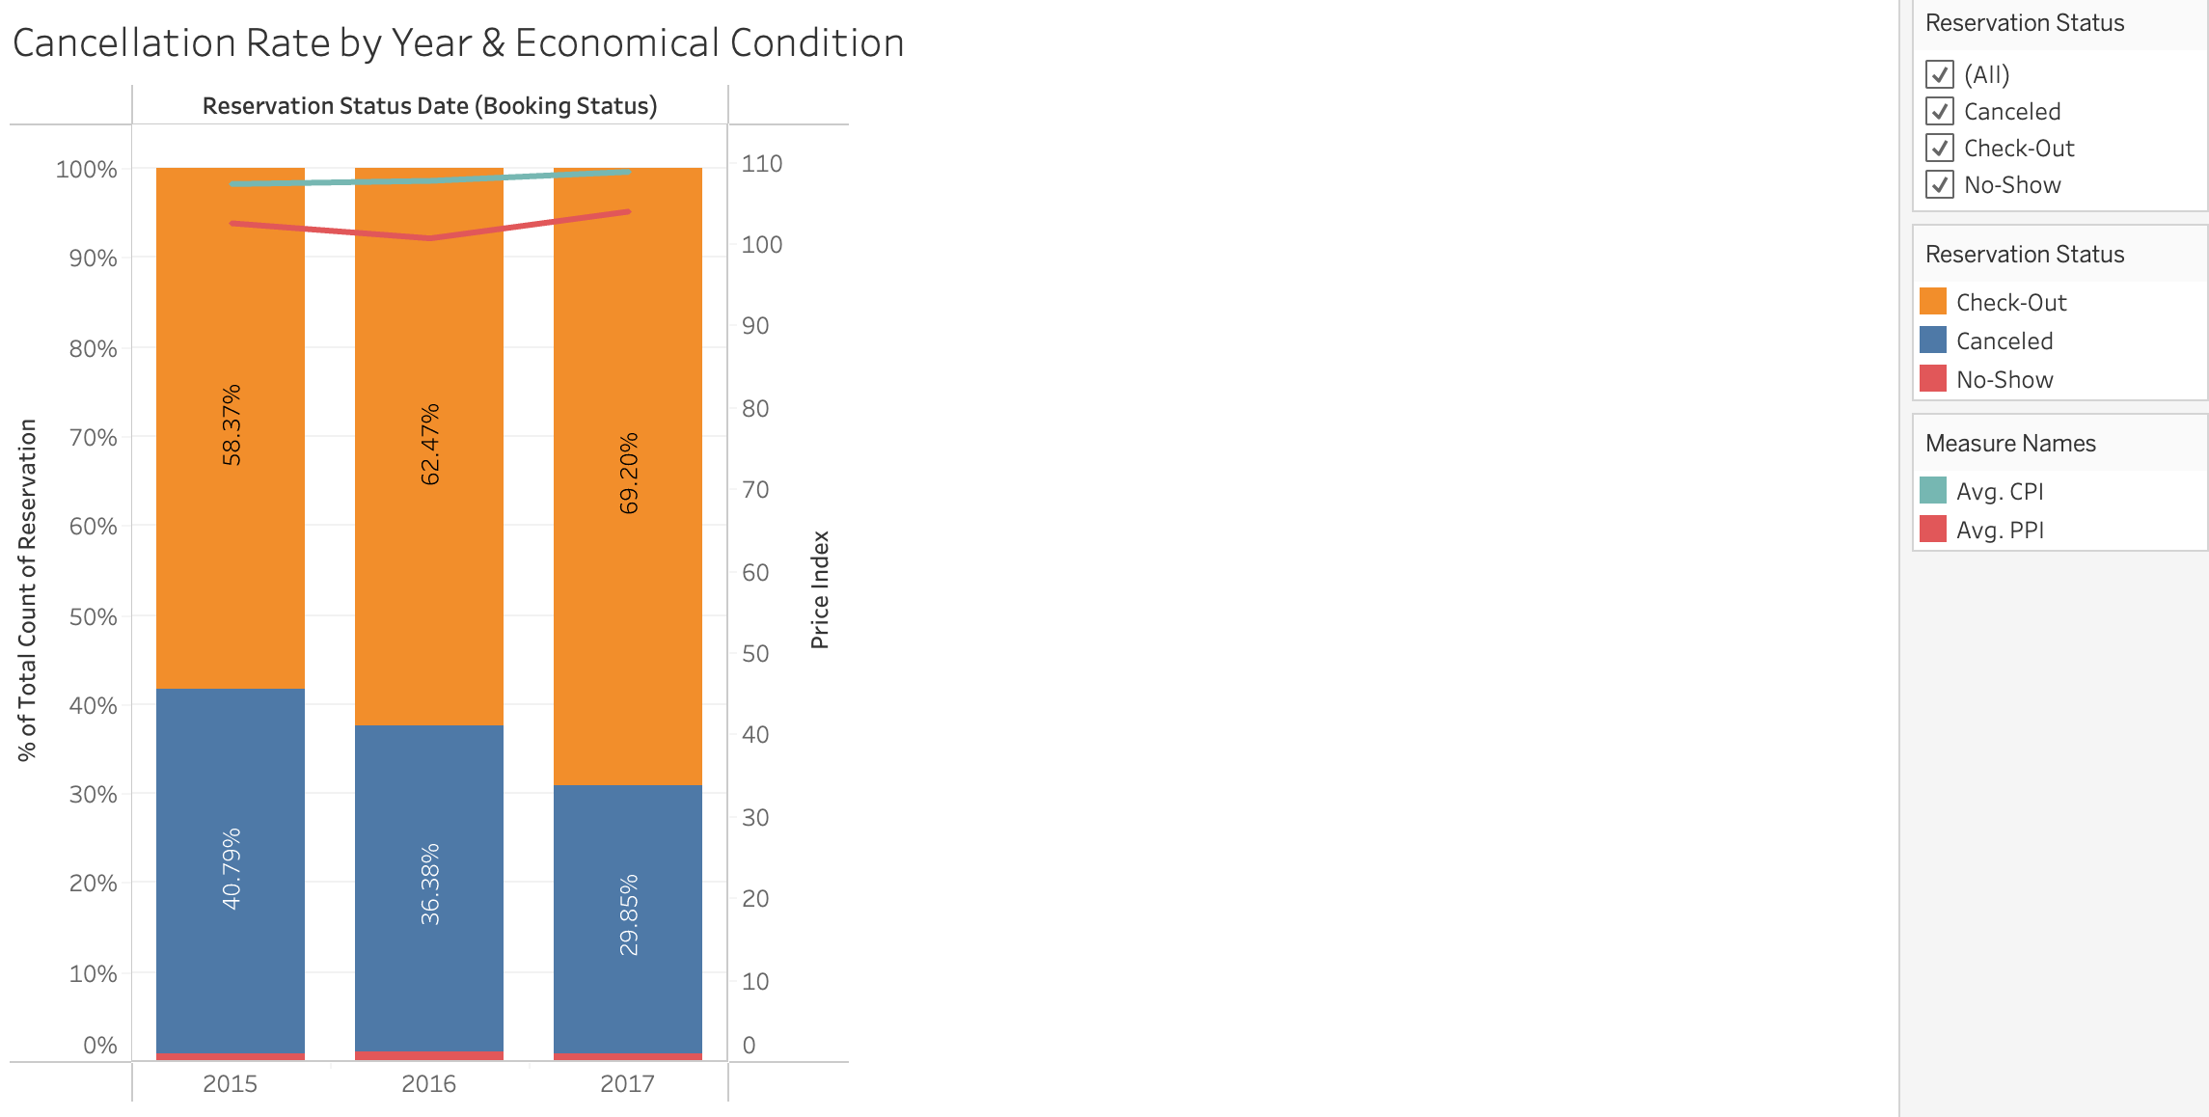
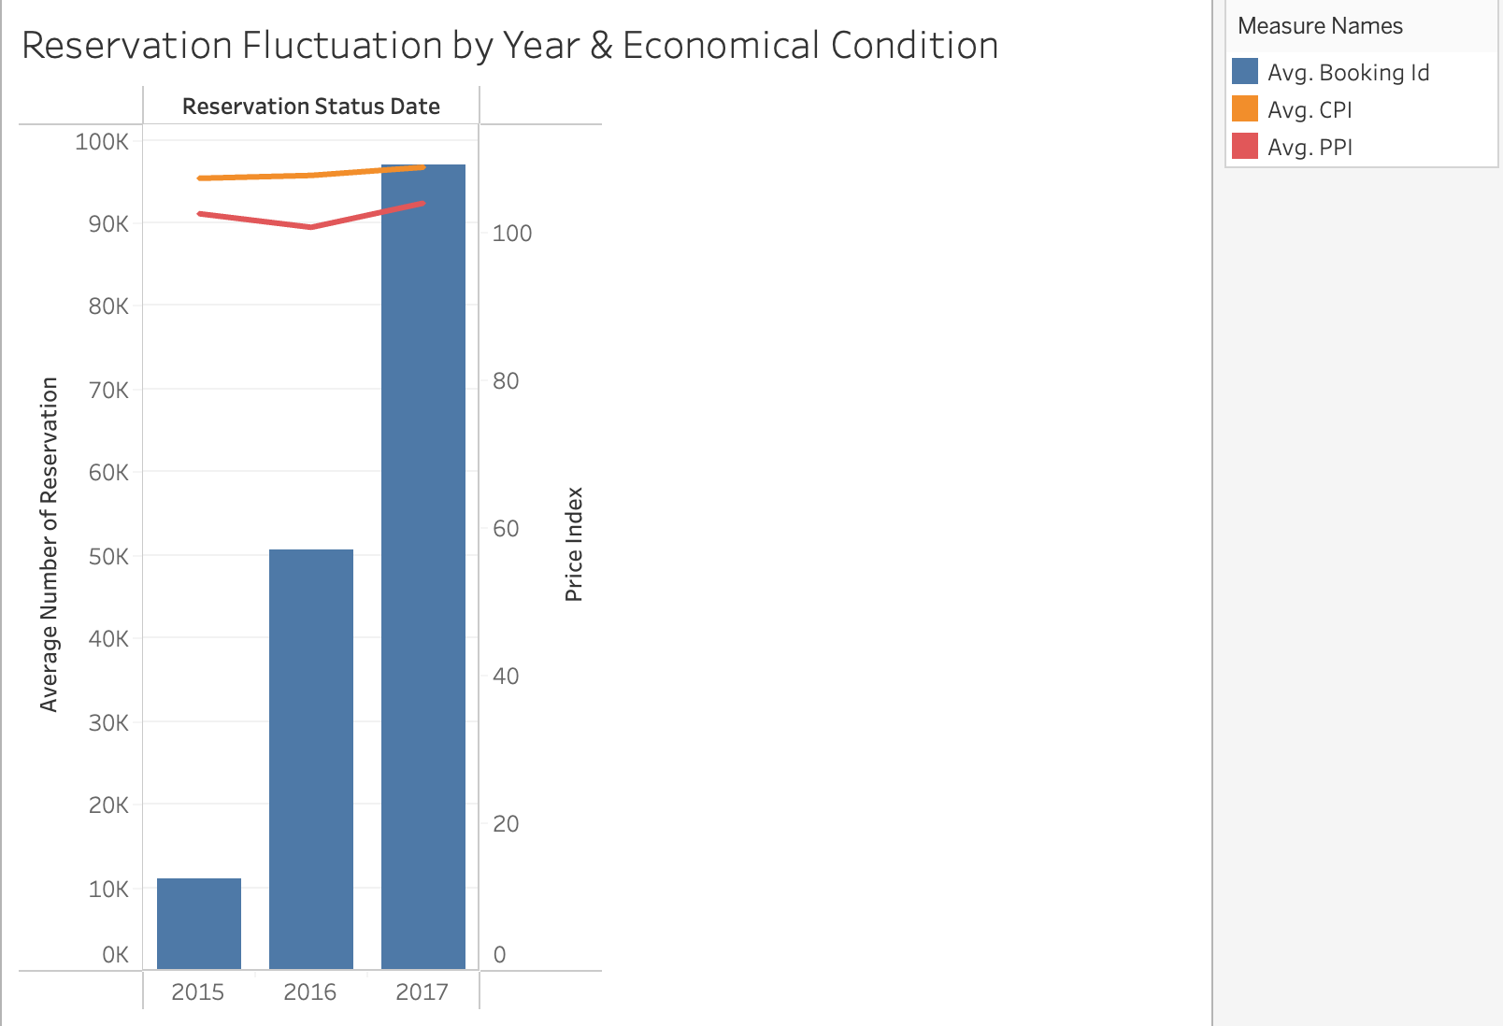
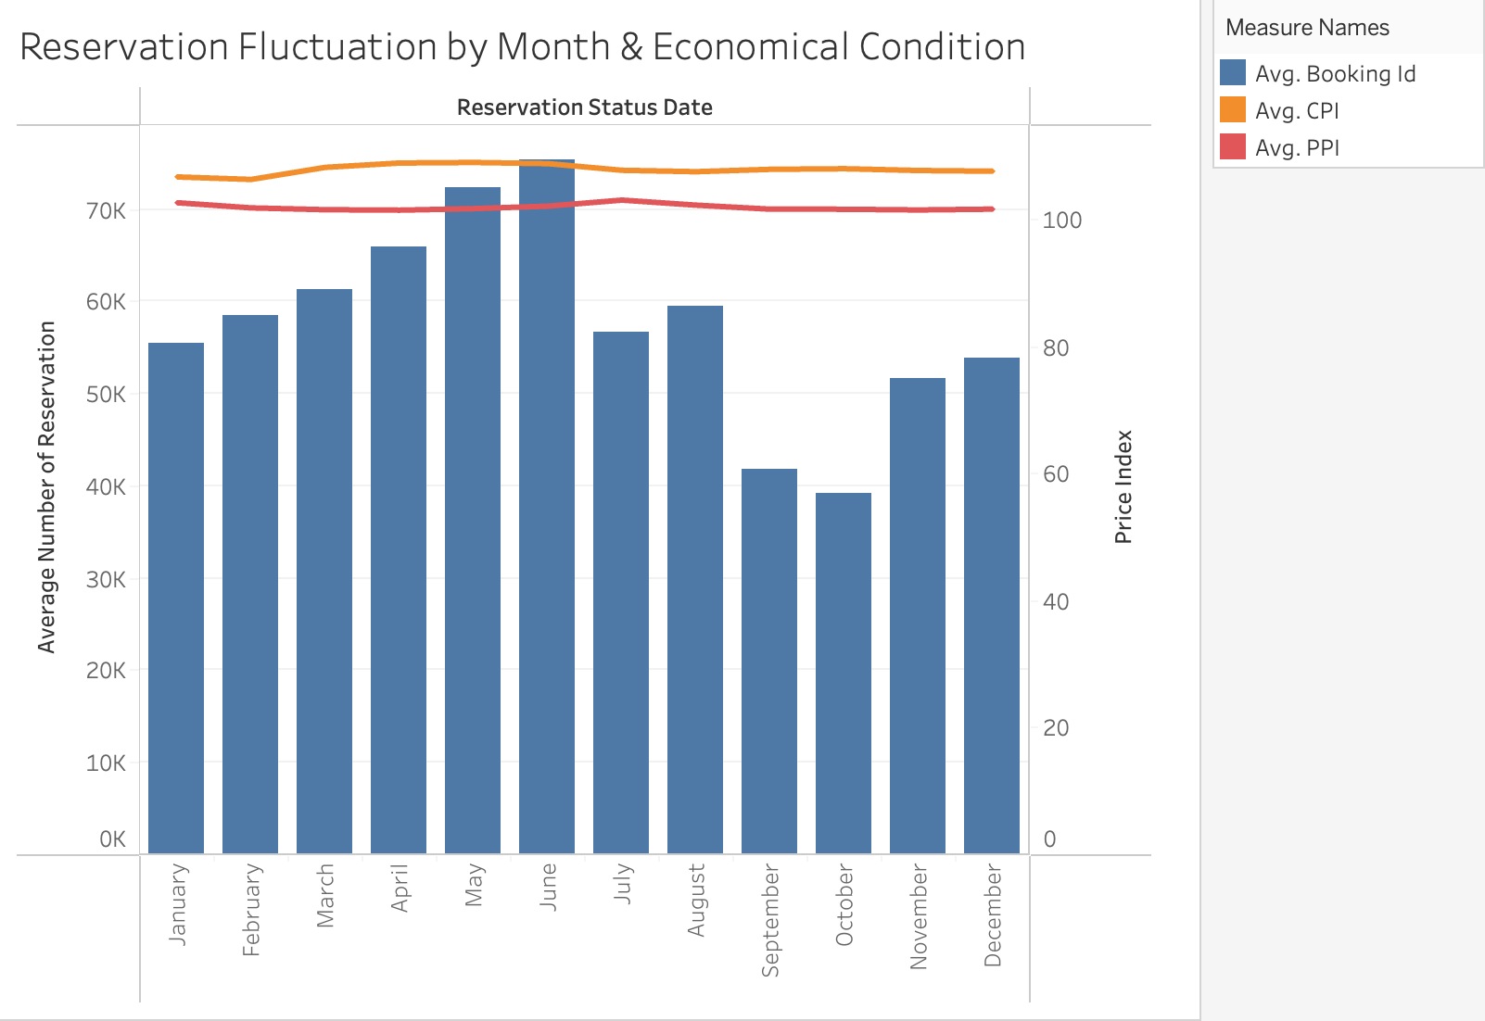
Cancellation Fluctuation by Economic Environment
CPI and PPI do not show significant correlation with the cancellation rate in the year dimension.
In the month dimension, there is a negative correlation between PPI and cancellation rate.

Slide 16
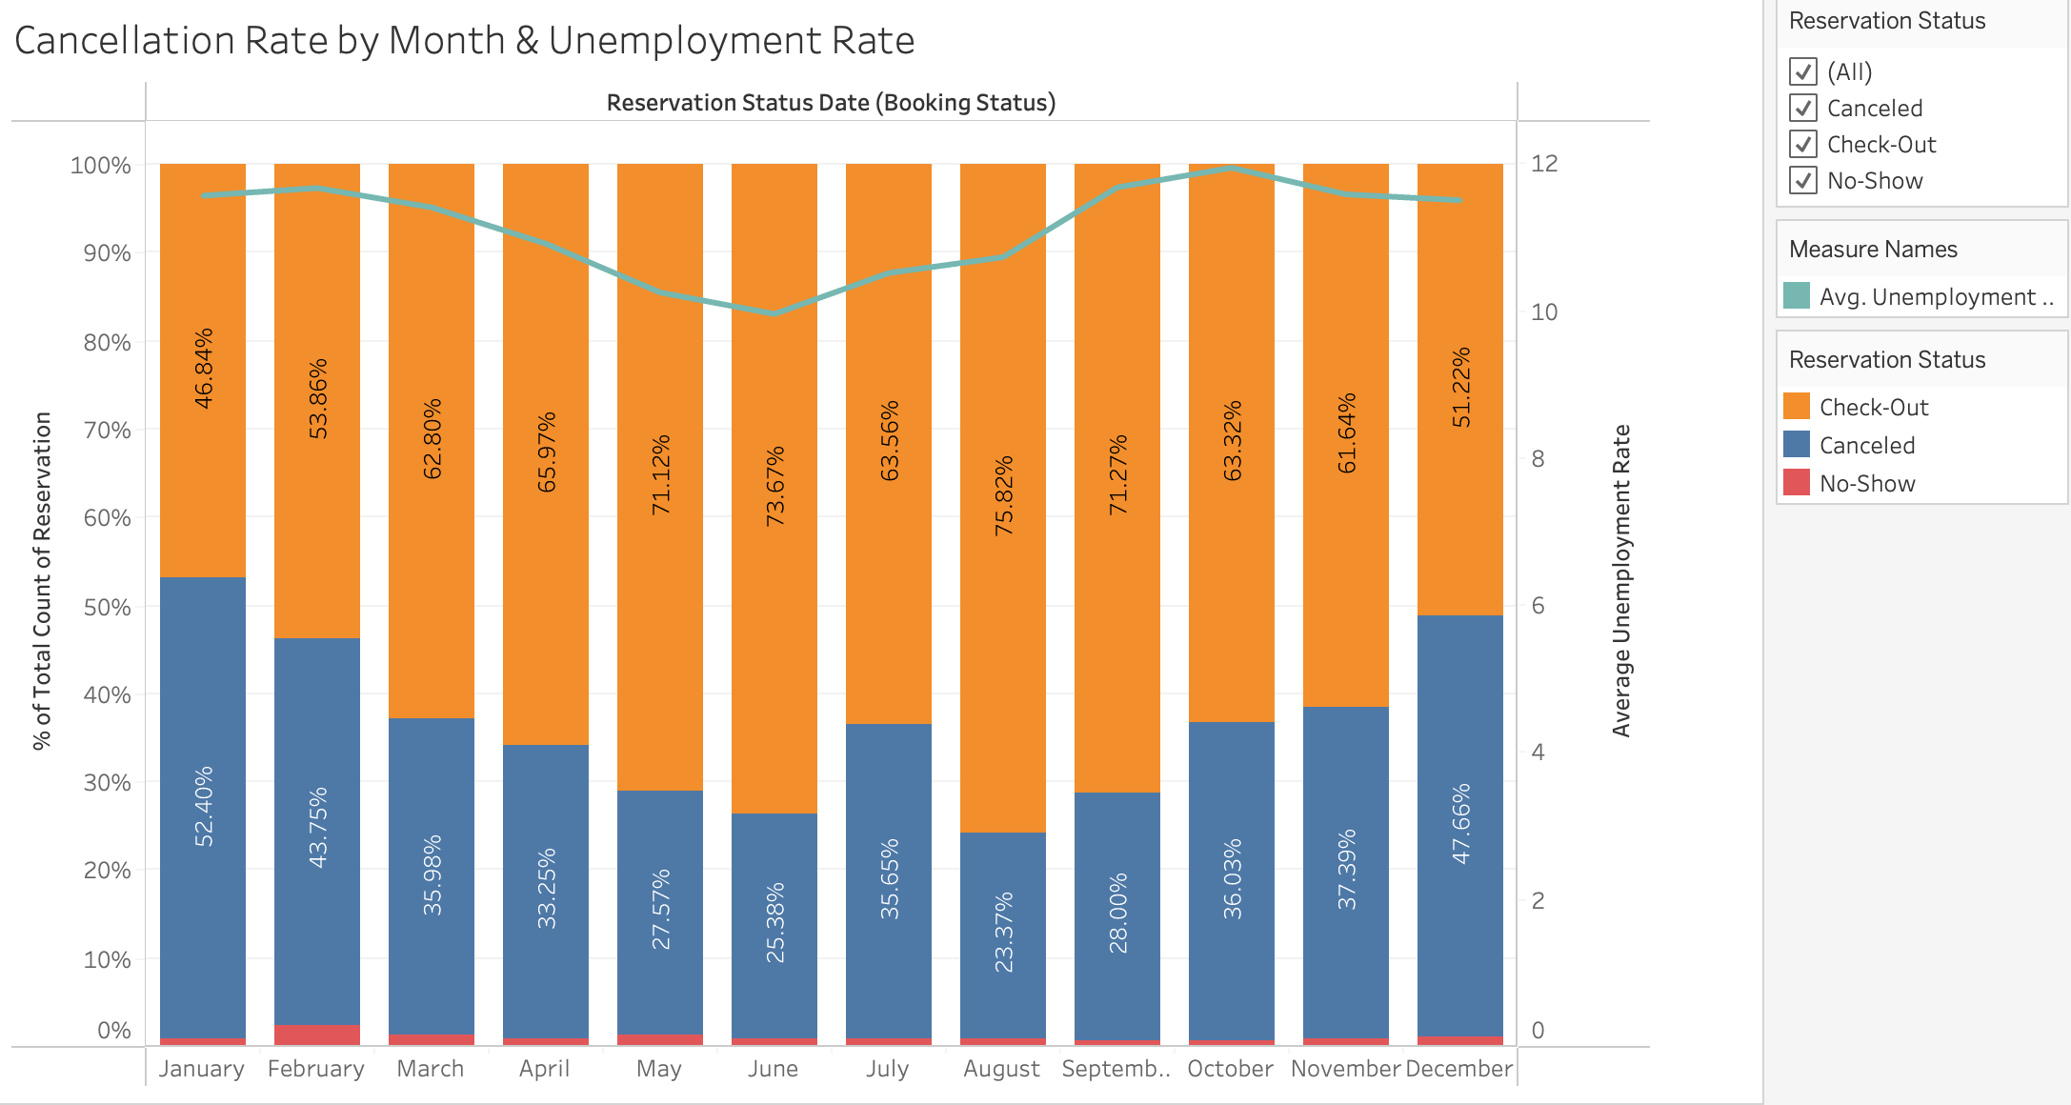
Cancellation Fluctuation by Economic Environment
The unemployment rate has a positive relationship with cancellation rate.

Slide 17
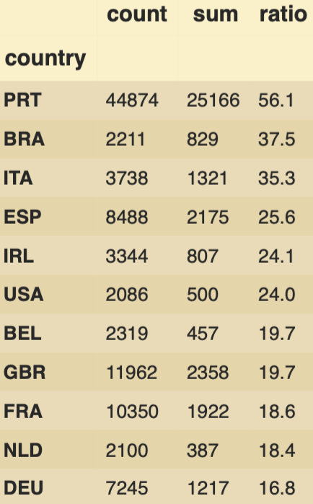
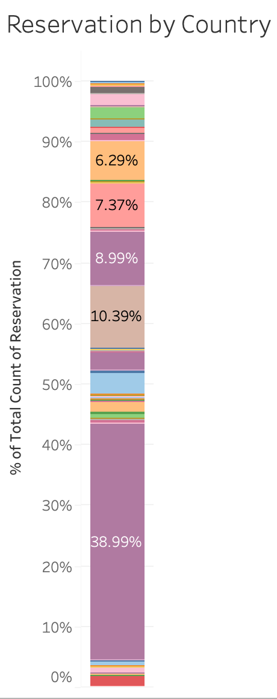
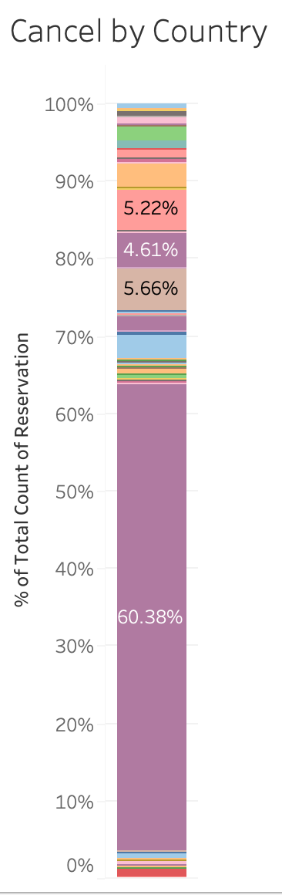
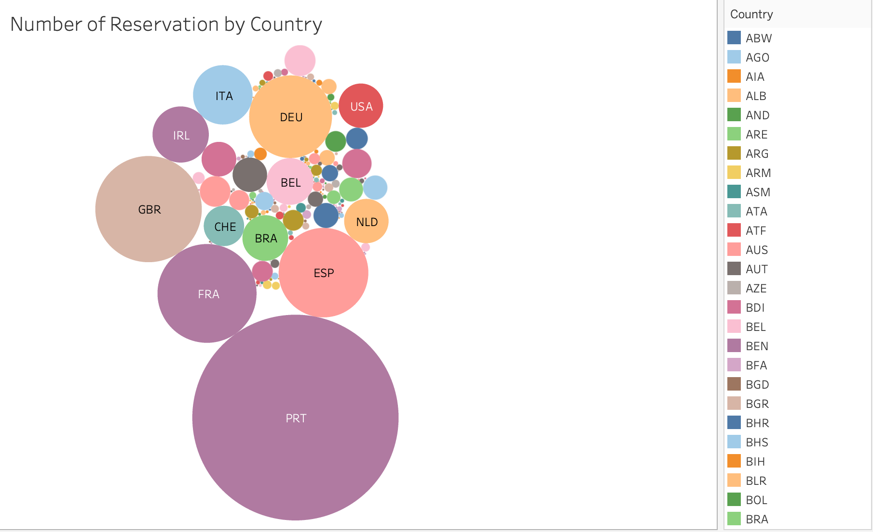
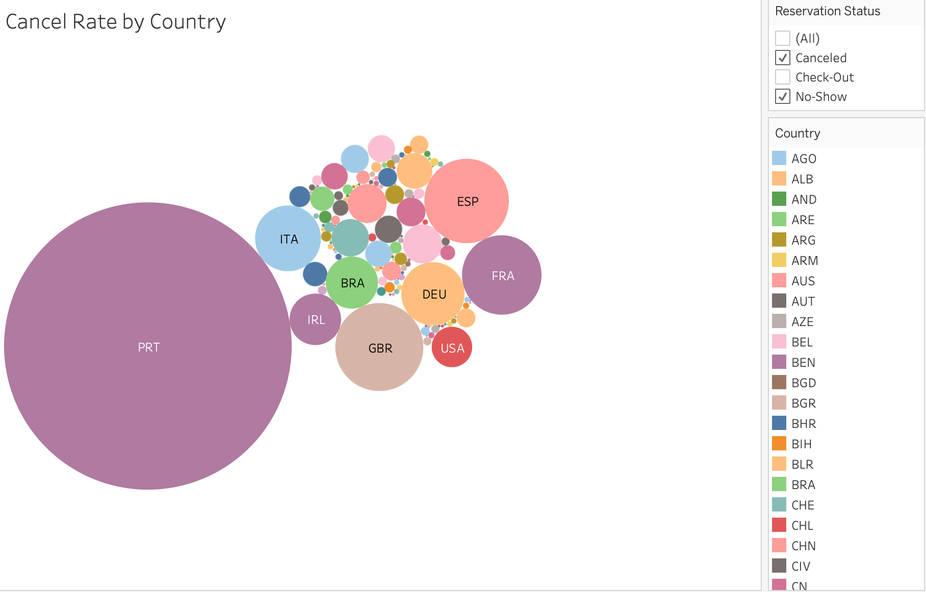
Portugal – high % of reservation, but higher cancellation >> what does it mean, Portugal cancel higher than other countries
Country of Origin
The cancellation rate of PRT (Portugal) is significantly higher than that of other countries. (Domestic traveler might have a higher flexibility on travel plan)
DEU
ESP
ESP
FRA
GBR
FRA
GBR
PRT
PRT

Slide 18
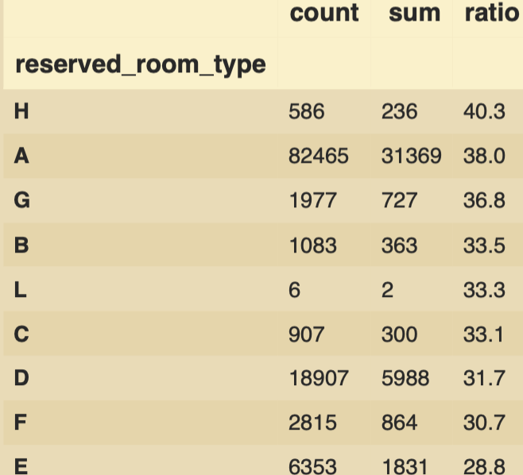
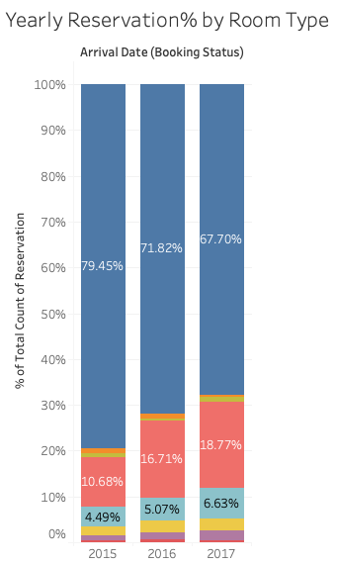
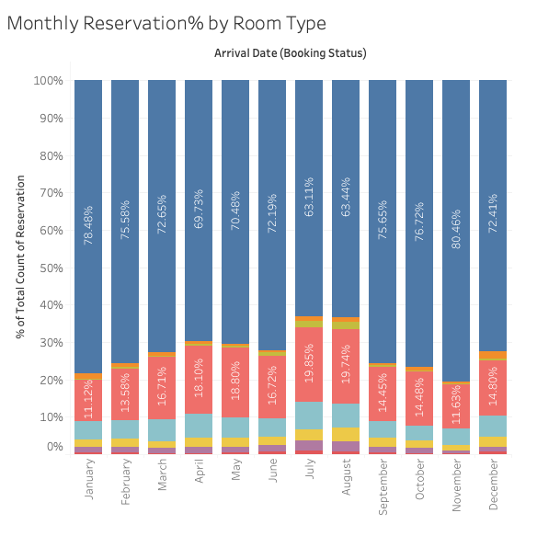
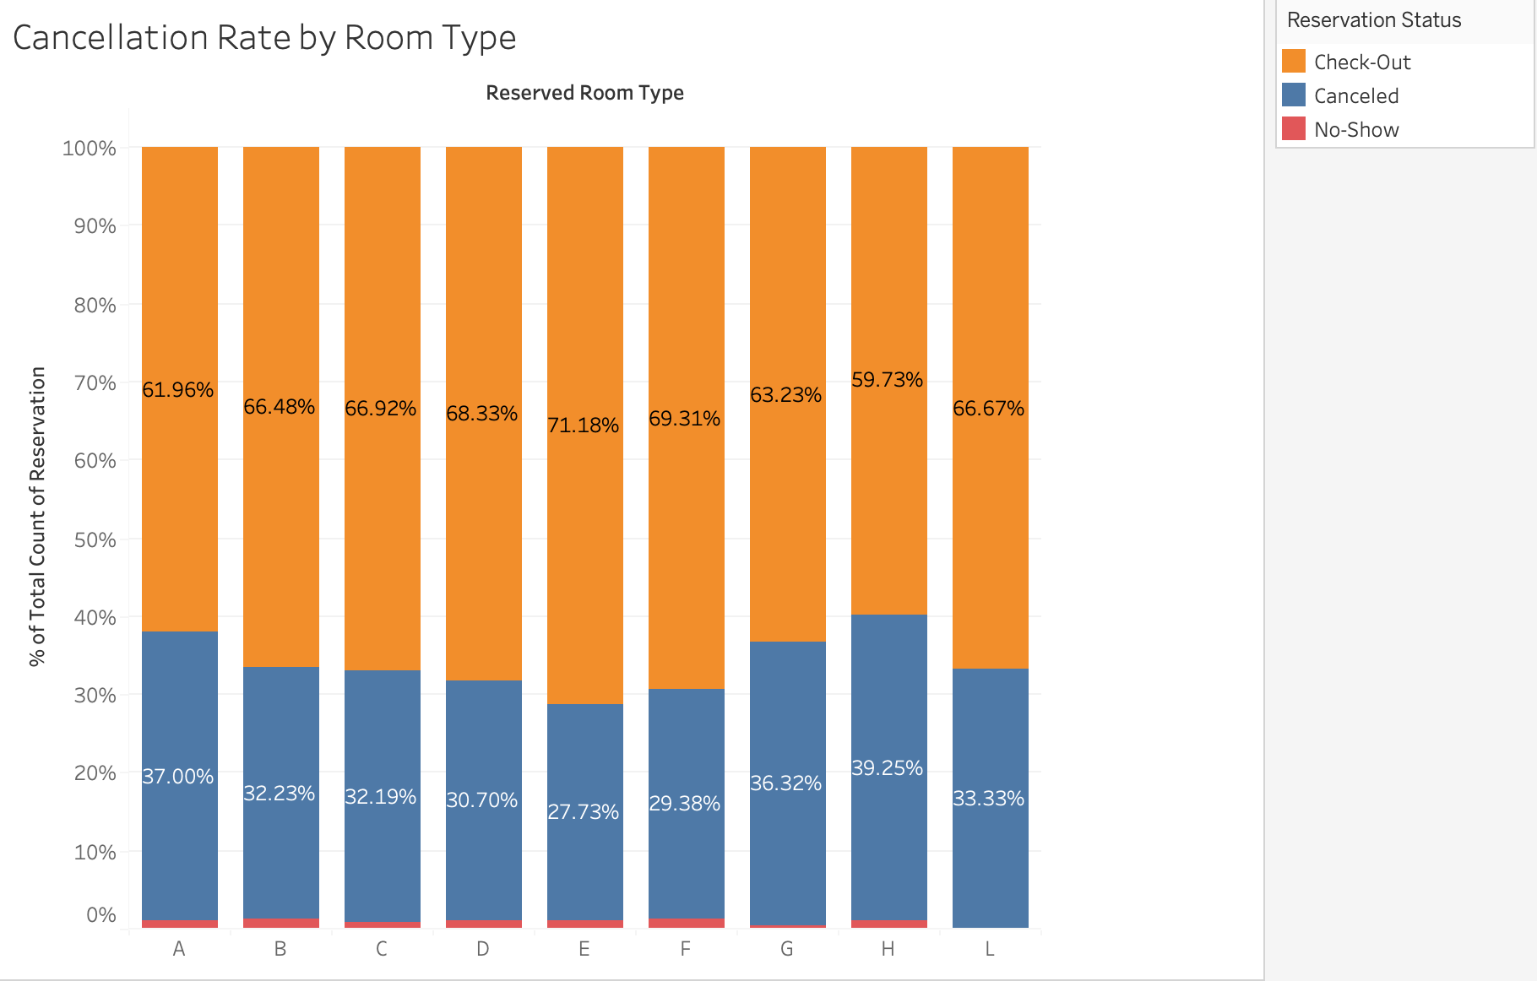

Room Type
Room types A, D, and E are the most popular, with not much difference in seasonality.
The reservation proportion of room type A has decreased, while the proportions of room types D, E, F, and G have increased.
The cancellation rate for each room type ranges from 27% to 39%. Room types H and A have the highest cancellation rates.

Slide 19
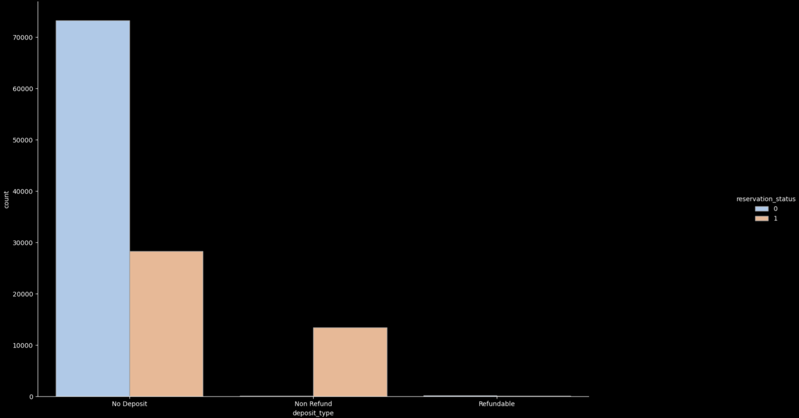
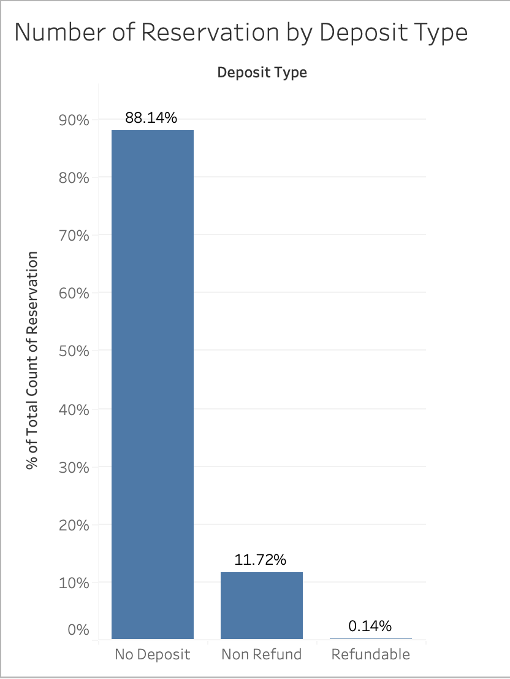
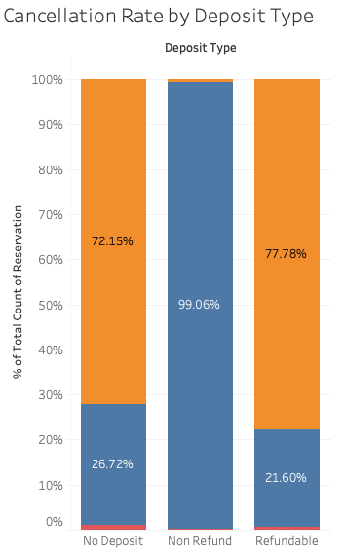
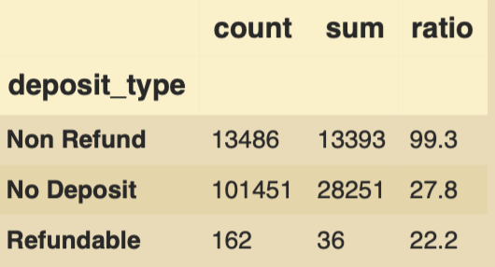
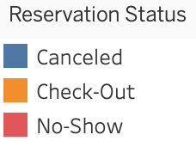
Deposit Type
88% of reservations do not require a deposit, while 12% is non-refundable
The non-refundable payment reservations have the highest cancellation rate at 99% (Usually, the cheapest room will have a no-refund policy)
Cheap room and deposit rate is not high

Slide 20
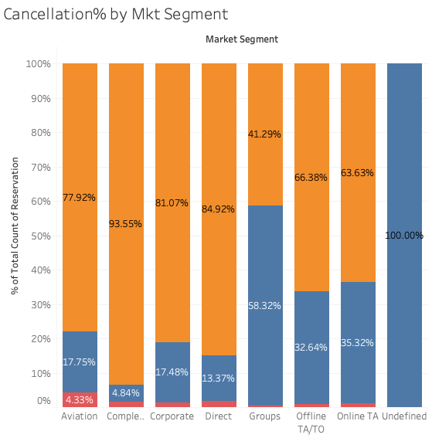
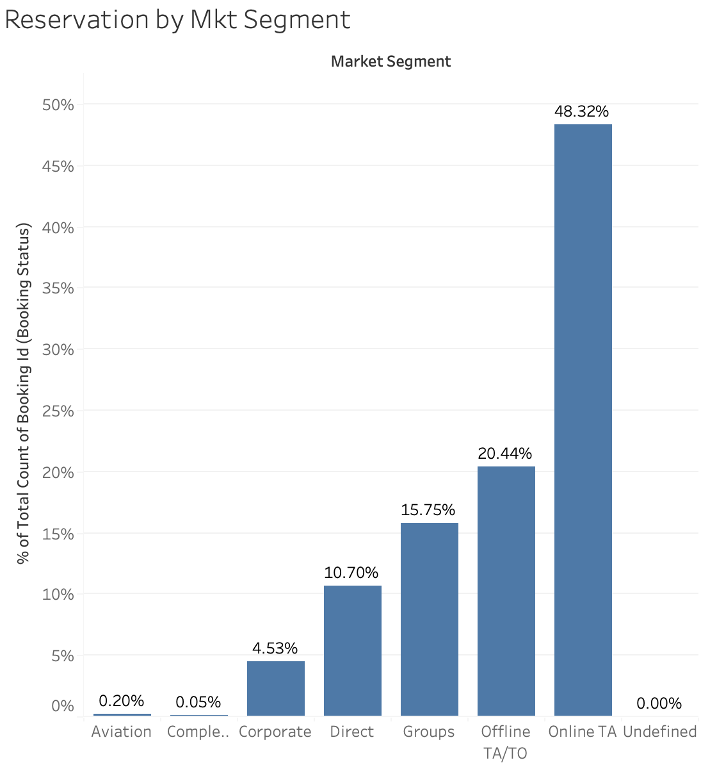
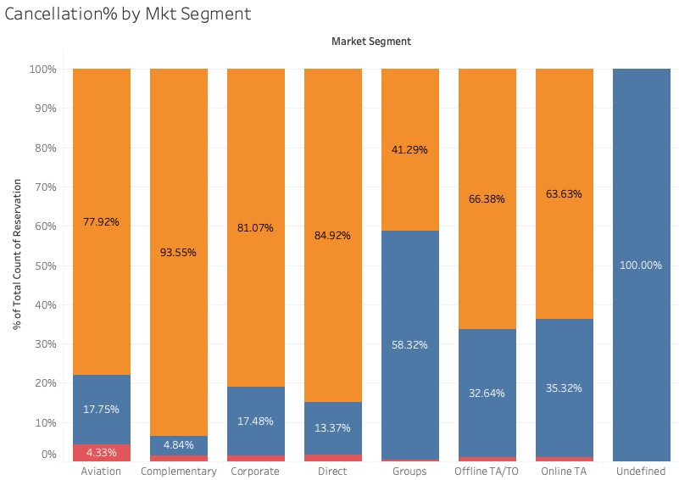
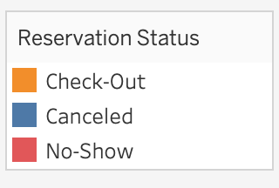
Market Segment
Almost half of the customers are located under the Online Travel Agent segment.
The Group segment has the highest cancellation rate at 58%, for TA/TO is about 40% (Hotels usually provide a flexible cancellation policy for group & agent clients, while group & agent also tend to make bookings in advance to secure a certain number of rooms at negotiated rates)
Enjoy flexible cancellation policies, and they also overbook in advance
Notes:
Market segment designation. In categories, the term “TA” means “Travel Agents” and “TO” means “Tour Operators”
The complimentary market segment consists of individuals or groups who are provided with certain services or products free of charge as part of their stay at the hotel. For example, frequent customers orloyalty program members (i.e. AMEX free hotel booking).

Slide 21
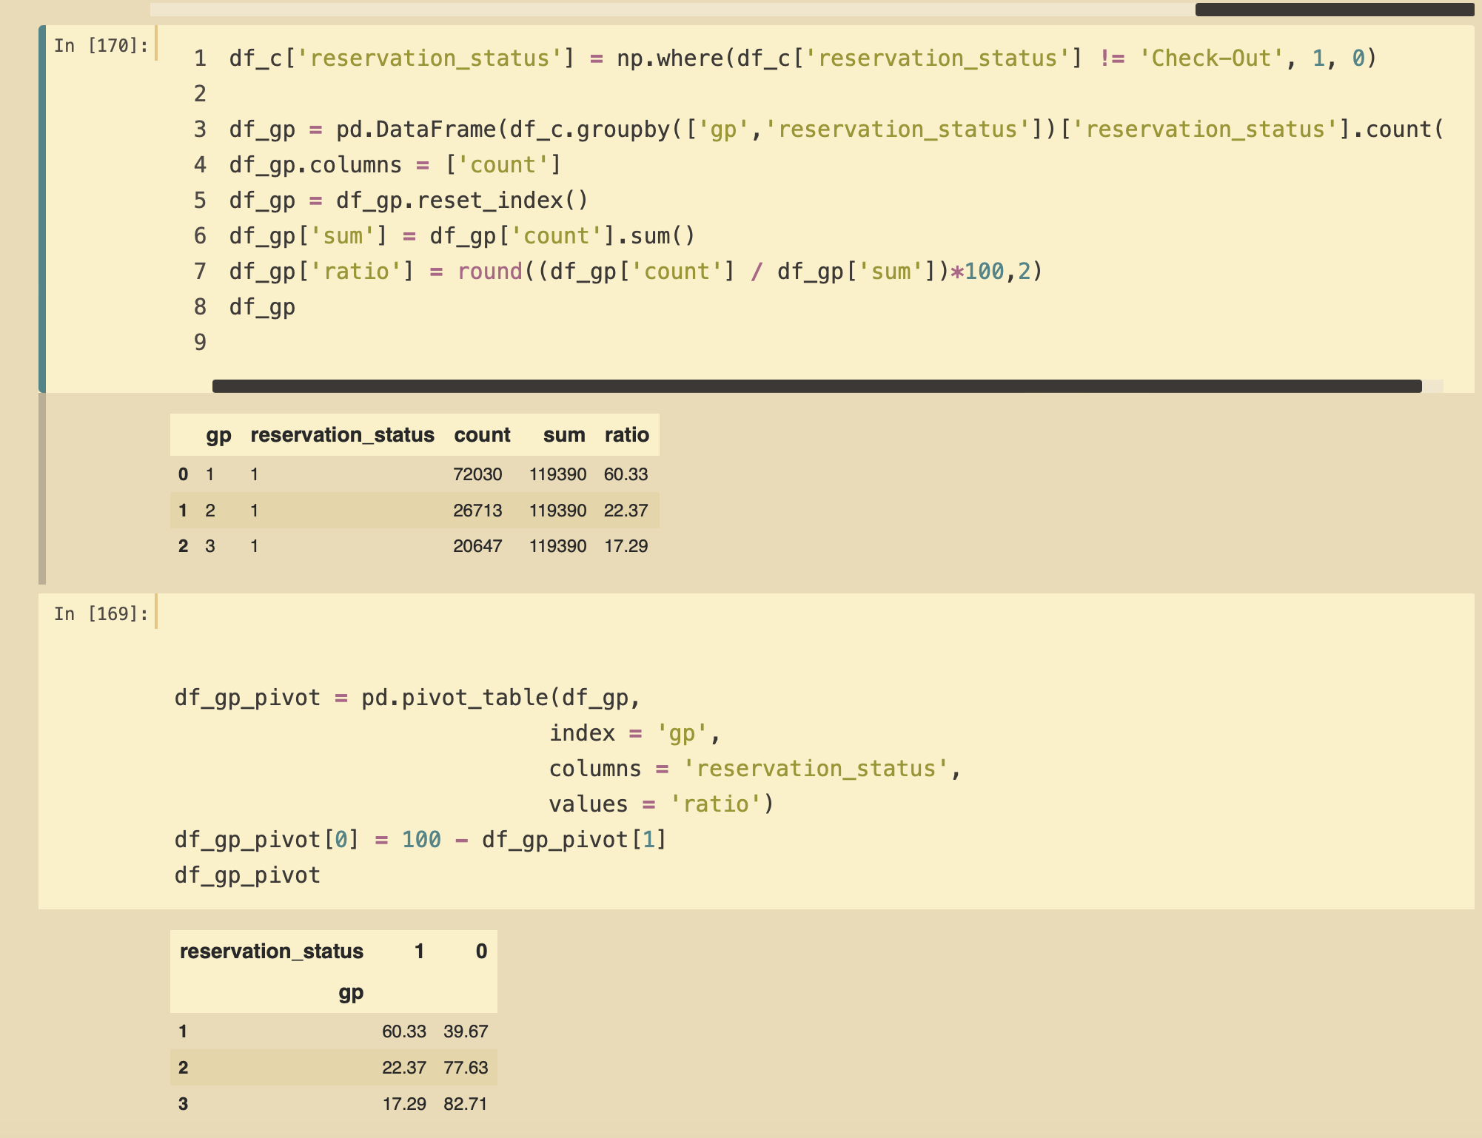
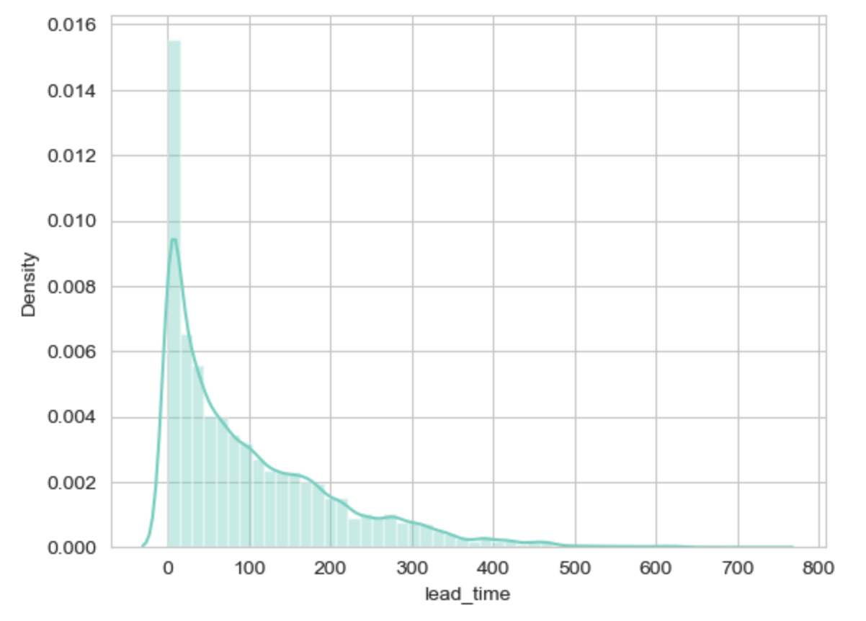
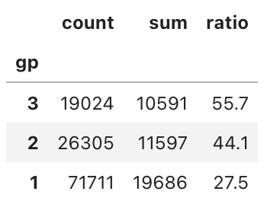
Reservation Leadtime
The lead time between the room booking date and the arrival date are right skewed, vary from 0 to 800 days.
The longer the lead time is, the higher the potential for the order to be canceled.
Cancellation Orders by Leadtime
20647
119390
17.29%
26713
119390
22.37%
72030
119390
60.33%
Cancellation Rate by Leadtime
1
0
1=cancel
0=check-in
Gp1= leadtime < 100 days
Gp2= 100< leadtime < 200 days
Gp3= leadtime > 100 days
60.33
39.67
22.37
77.63
17.29
82.71

Slide 22
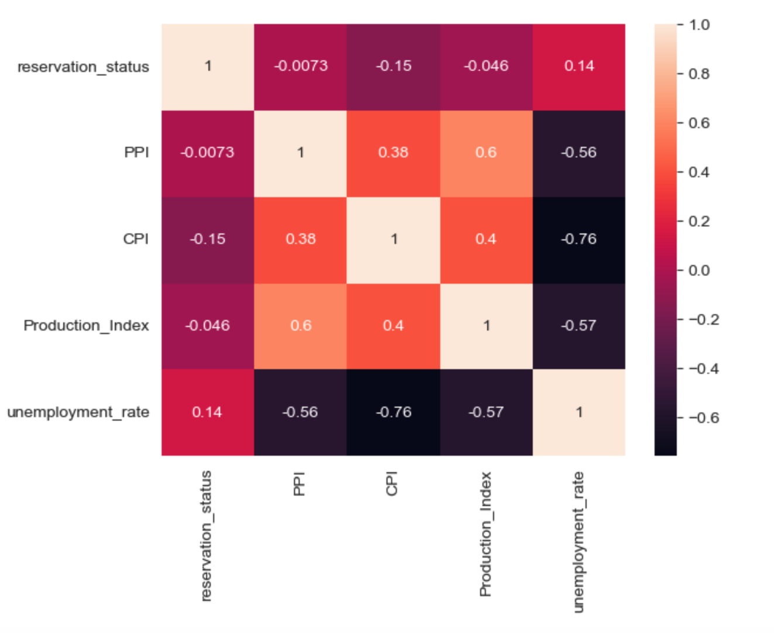
Correlation between Cancellation Rates & Economic Environment
Cancellation rate has a negative correlation with economic factors such as CPI, Production Index, and PPI.
Cancellation rate has a positive correlation with unemployment.
1=cancel
0=check-in

Slide 23
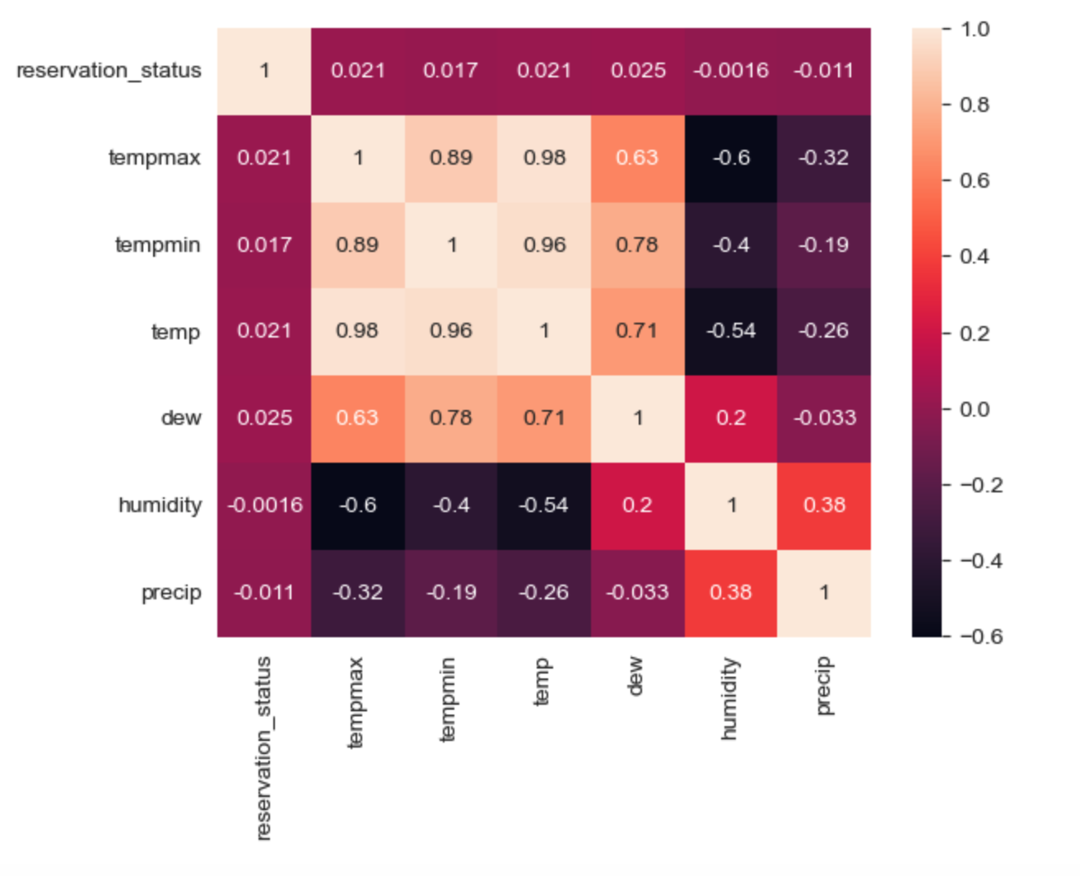
Correlation between Cancellation Rates & Weather
The relationship between weather and cancellation rate is insignificant.
1=cancel
0=check-in

